Slide 1
Telling Your Story with Data
Assembling the figures you want for your lab report.

Slide 2
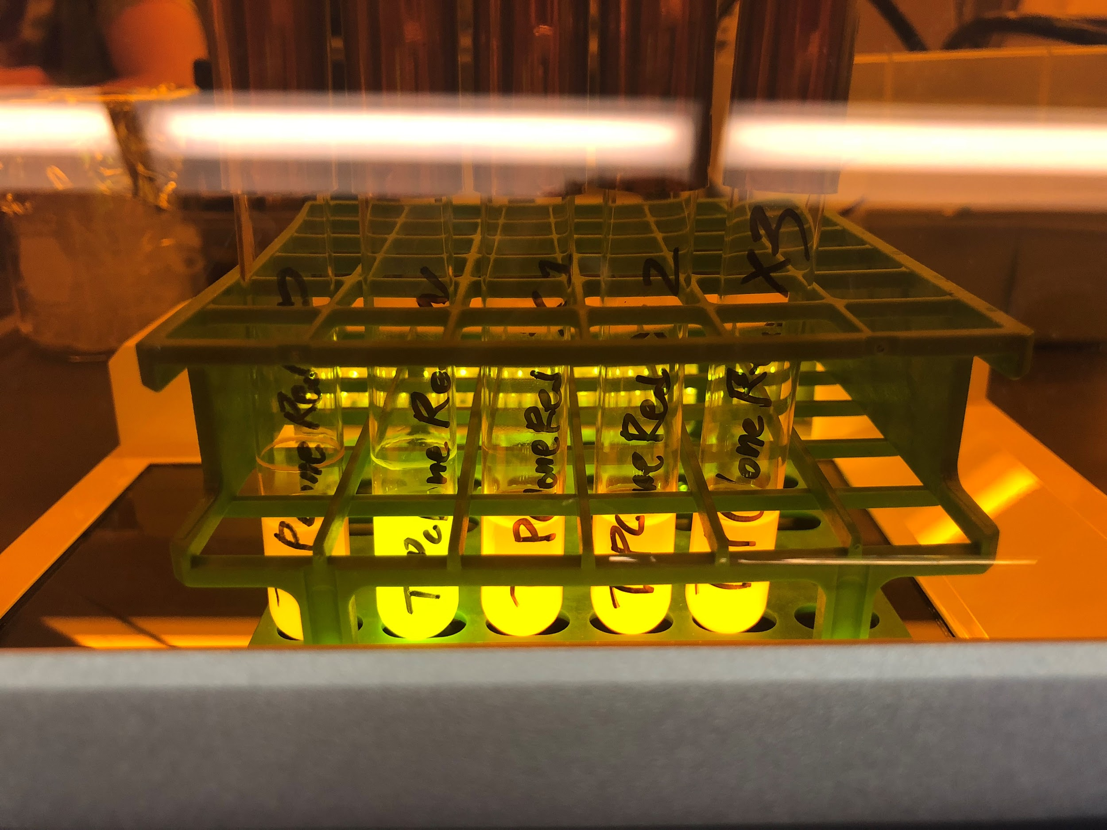
Telling Your Story with Data
Which version is better, and why?
What would make this even better?

Slide 3
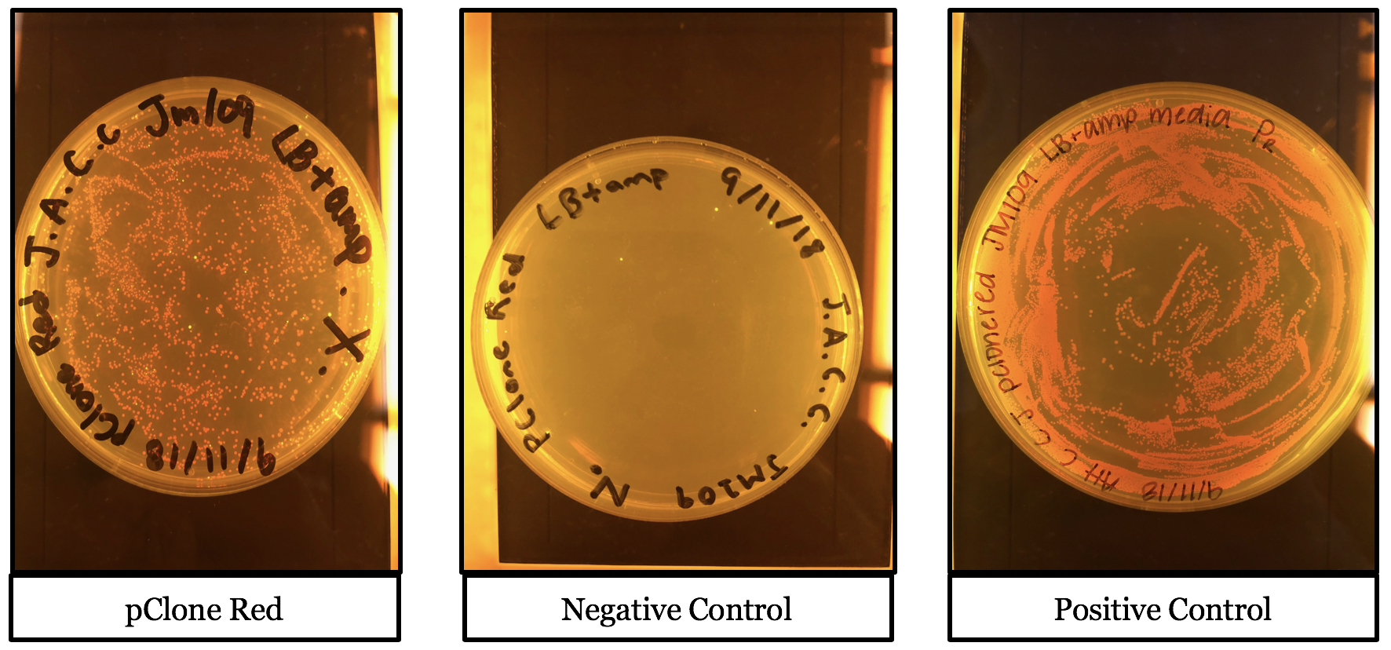
Telling Your Story with Data
Which version is better, and why?
What would make this even better?

Slide 4
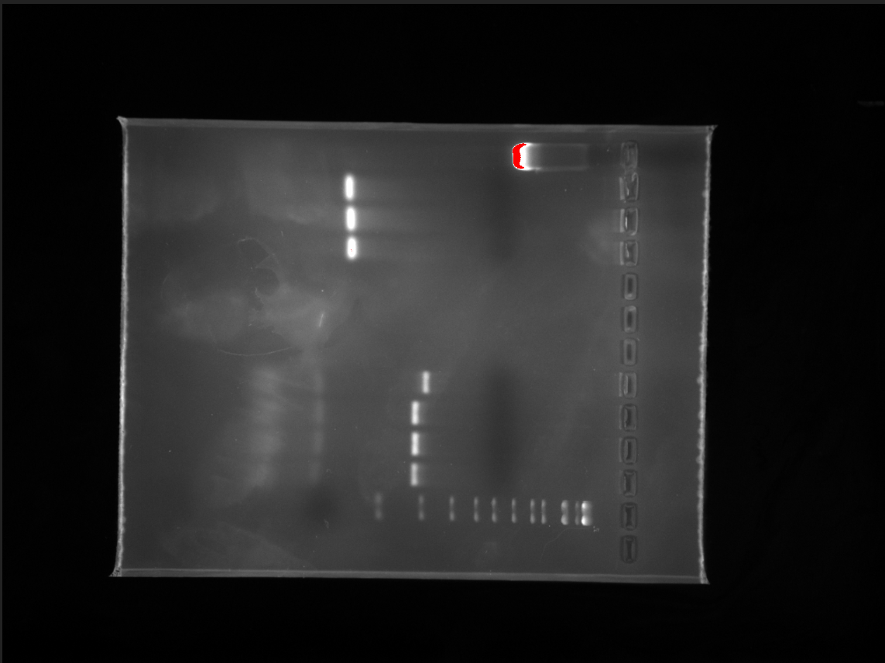
Telling Your Story with Data
Which version is better, and why?
What would make this even better?

Slide 5
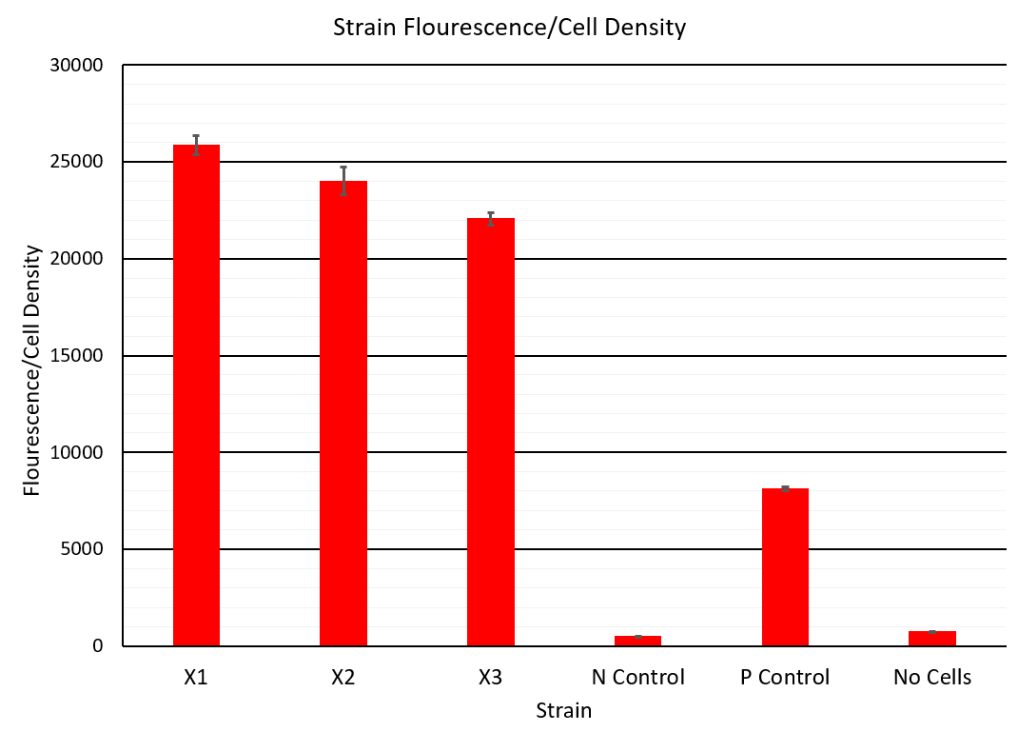
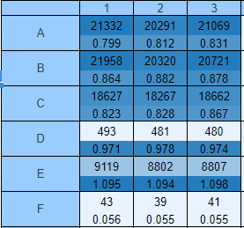
Telling Your Story with Data
When you have a graph, do you want to see the raw data?

Slide 6
Telling Your Story with Data
Do you have to use all your data? Which ones do you choose, and why?

Slide 7
Telling Your Story with Data
Figure 1. Summary statement here. Description of how the data were collected and any calculations you performed. Explain what error bars are. Title on graph not needed when figure legend is present.

Slide 8
Telling Your Story with Data
In the text, is it OK to simply say?
Results
We measured our cells (Figure 1).
Discussion
We got good results.

Slide 9
Telling Your Story with Data
Start with visual outline of your story.
Choose your figures, but only the ones that help tell your story.
Write the figure legends.

