Slide 1
Title Page
Integrated Systems Biology
PowerPoint Slides for Chapter 12:
Cells at the Cellular Level
12.1 How do I tell my muscles to move?
by
A. Malcolm Campbell, Laurie J. Heyer, and Chris Paradise

Slide 2
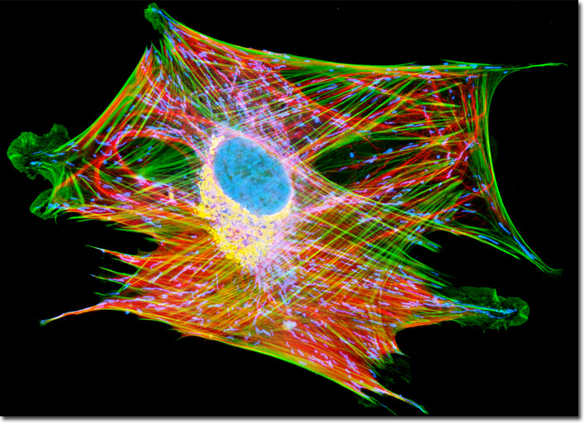
Opening Figure
Cells Processing Information
Notes:
Opening Art: DNA contains instructions but each cell must construct its own components to perform a function.

Slide 3
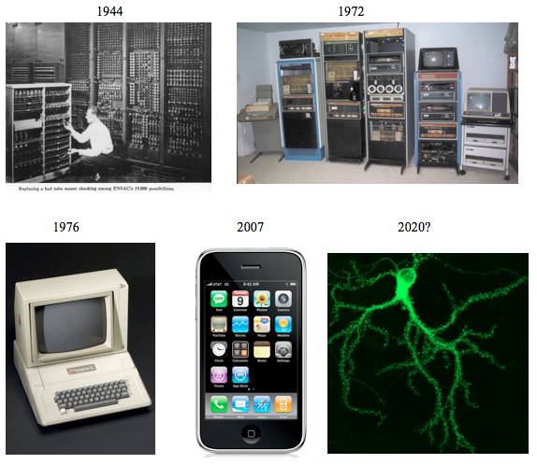
Fig. 12.1
Evolution of Computers
Notes:
Figure 12.1 Evolution of computers. Computers have continued to get smaller and perhaps cells will be re-engineered into computers as part of a new species of humans.

Slide 4
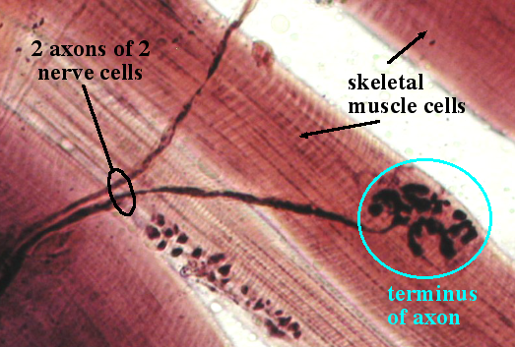
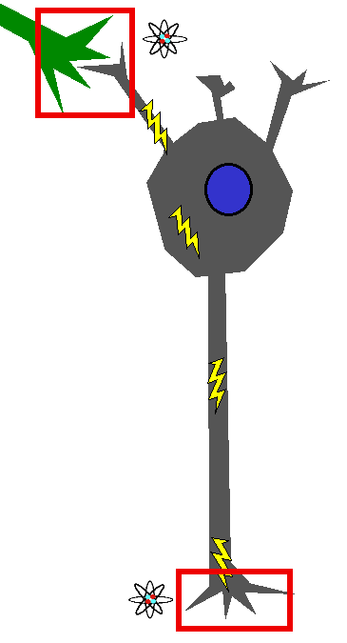
Fig. 12.2
Cellular Communication of Neurons
Notes:
Figure 12.2 Neurons use chemical and electrical signals to communicate information. a) Nerve cells send long axons to terminate on skeletal muscle cells. b) Neurons receive chemical inputs, convert them to electrical signals that quickly convert the information to chemical outputs. Chemical information is indicated by red boxes and atomic symbols; lightning bolts symbolize electrical signals.

Slide 5
Table 12.1
Table 12.1
Notes:
Table 12.1 Concentration of ions inside and outside animal cells.

Slide 6
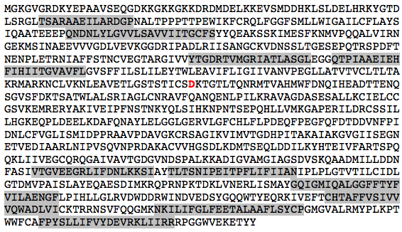
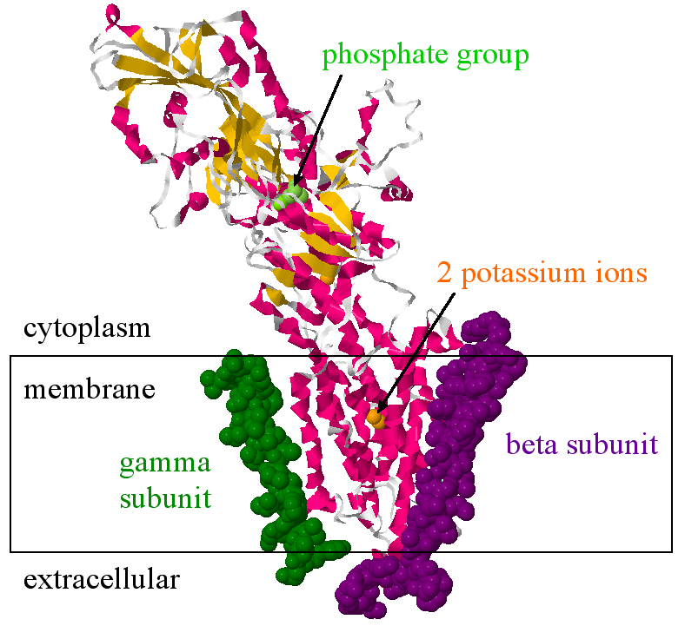
Fig. 12.3
Na⁺/K⁺ Pump Structure
Notes:
Figure 12.3 Primary and quaternary structure of a Na⁺/K⁺ pump. (a) Primary structure of one of three human Na⁺/K⁺ pump genes. Ten membrane sections are shaded gray and the phosphorylated amino acid is red. (b) Tertiary structure of the same Na⁺/K⁺ pump in panel a, along with two additional subunits, gamma and beta. You can view a pair of interactive sodium/potassium pumps.

Slide 7
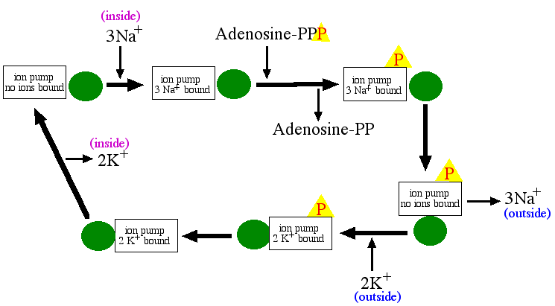
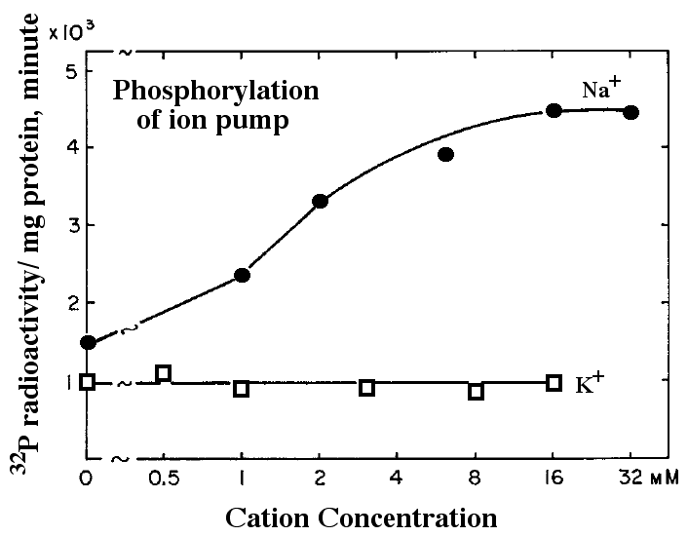
Fig. 12.4
Sodium Pump Activity
Notes:
Figure 12.4 Chemical activity of the Na⁺/K⁺ pump. a) Phosphorylation of the Na⁺/K⁺ pump was measured as a function of sodium or potassium ion concentration. b) Diagram of the Na⁺/K⁺ pump cycle. Green circles represent a modulation of the enzyme and subsequent shape change.

Slide 8
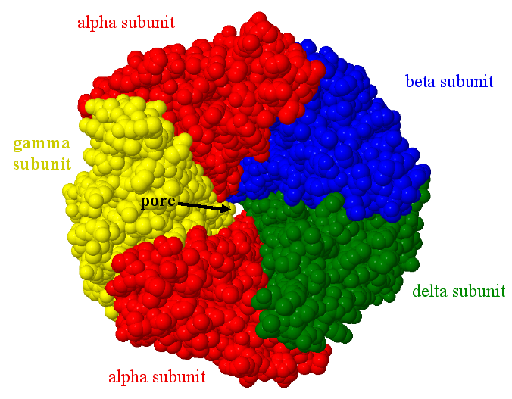
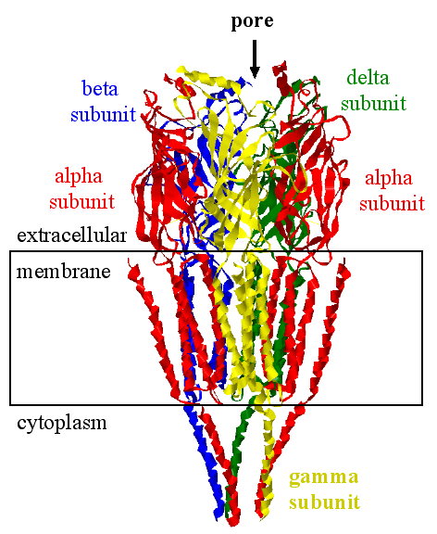
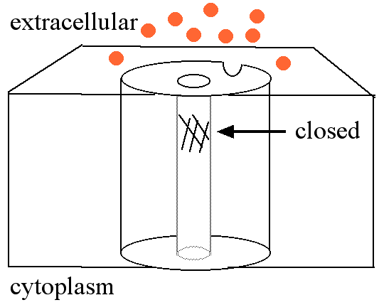
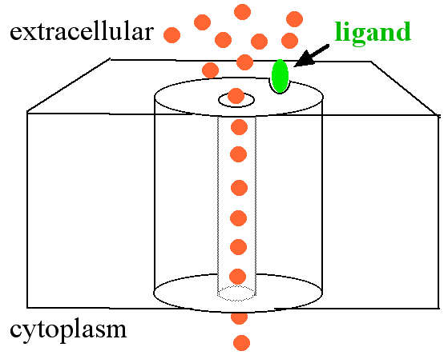
Fig. 12.5
Anatomy of Gated Ion Channels
Notes:
Figure 12.5 Gated sodium ion channel structure and function. (a) Channel viewed from the cytoplasmic side is composed of 5 subunits. (b) Side view of the same sodium channel but illustrated to show secondary structures. (c-d) Diagram of the gating mechanism that blocks or permits Na⁺ to flow down its concentration gradient.

Slide 9
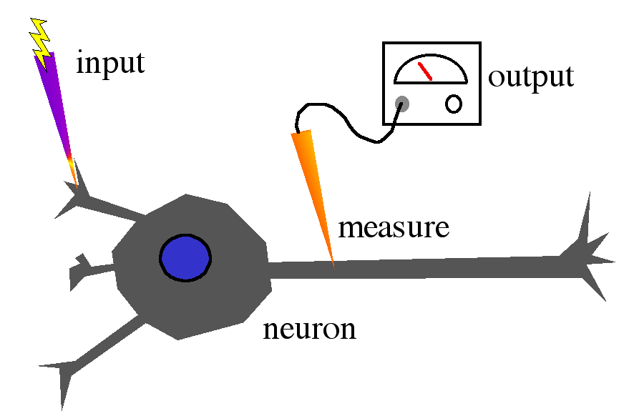
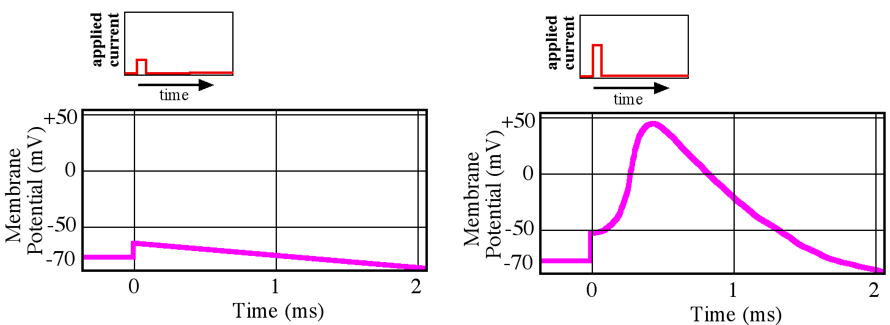
Fig. 12.6
Stimulated Neuron’s Reaction
Notes:
Figure 12.6 Stimulation and measurement of electrical current in neuron. (a) Stimulating electrode delivers known input current and a measuring electrode detects output current at its location along the axon. (b) Two different currents applied to a neuron and the resulting output current measured in the axon.

Slide 10
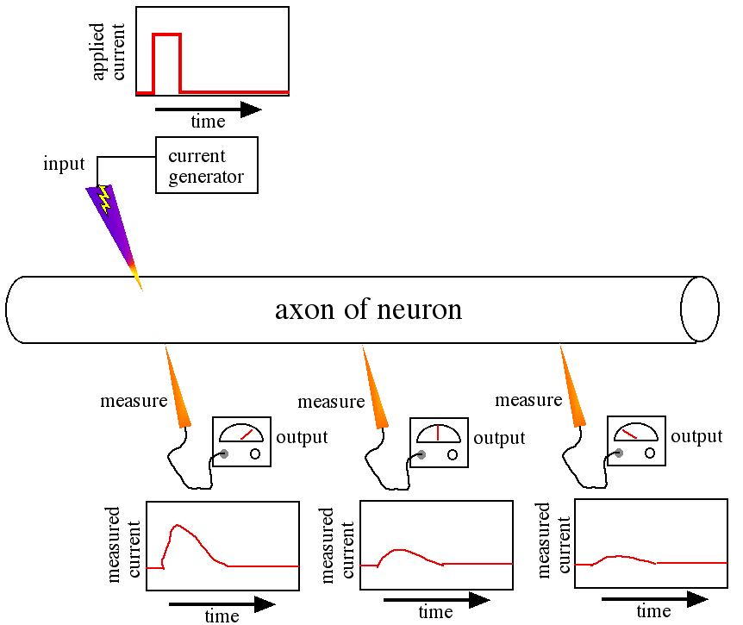
Fig. 12.7
Simultaneous Measurements
Notes:
Figure 12.7 Depolarization at one point in time. A neuron was stimulated (top left) and the depolarization was measured (bottom three probes) simultaneously at three distances from the site of activation.

Slide 11
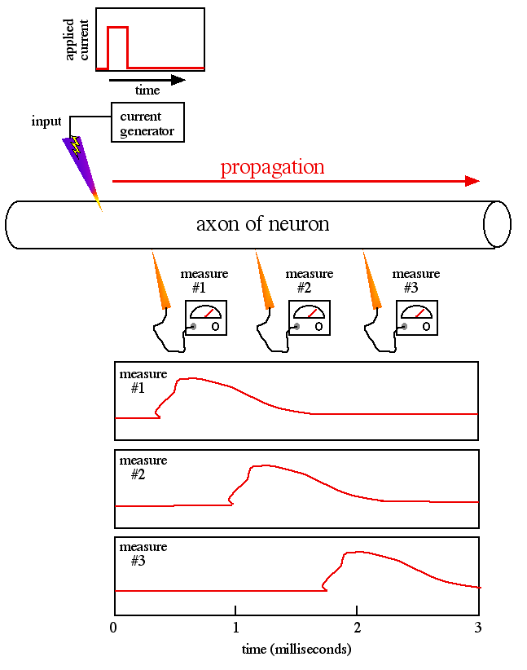
Fig. 12.8
Continuous Axon Measurements
Notes:
Figure 12.8 Depolarization over time. A neuron was stimulated (top left) and the depolarization was measured over 3 milliseconds at three distances (below neuron) from the site of activation.

Slide 12
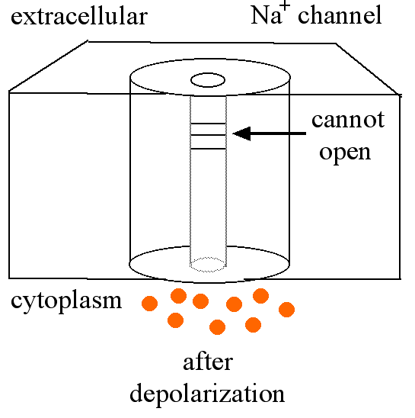
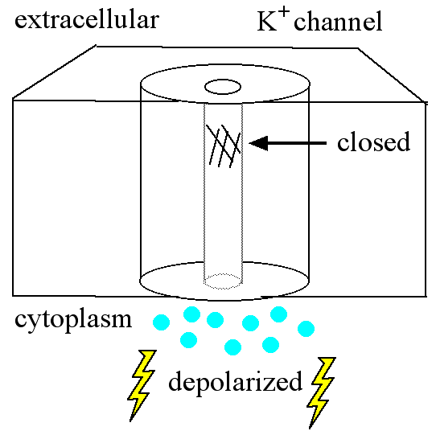
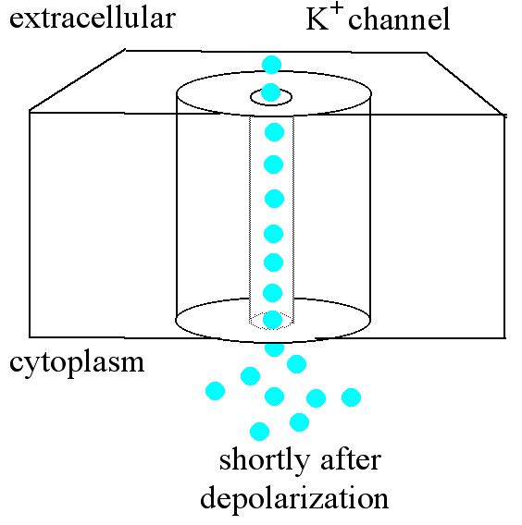
Fig. 12.9
Voltage-gated Ion Channels
Notes:
Figure 12.9 Neuron repolarization. (a) Once closed, a voltage-gated sodium channel cannot open again for a few milliseconds. (b-c) Voltage-gated potassium channels require threshold depolarization but their gating is time-delayed.

Slide 13
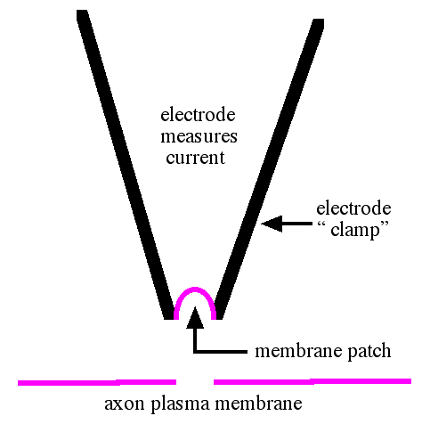
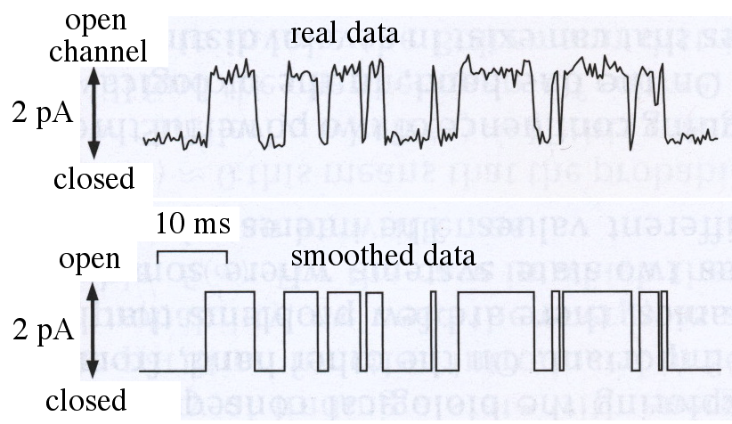
Fig. 12.10
Patch Clamp Method and Data
Notes:
Figure 12.10 Patch clamp method and single channel measurements. (a) Pipet removes a patch of membrane containing an ion channel. (b) Measured current from a single ion channel.

Slide 14
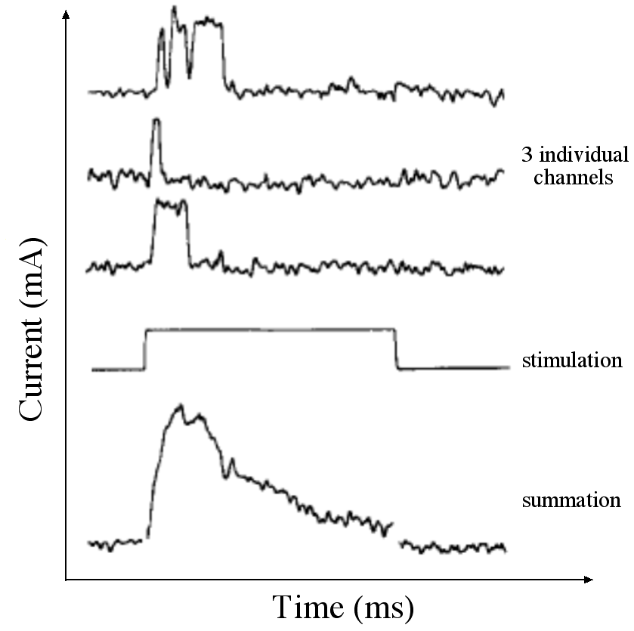
Fig. 12.11
Noise & Average Channel Activity
averaged output from 100 channels
average
Notes:
Figure 12.11 Three individual ion channels and average current. Current measurements from three independent ion channels produced by a common stimulation. The average current is the average of more than 100 such individual current measurements.

Slide 15
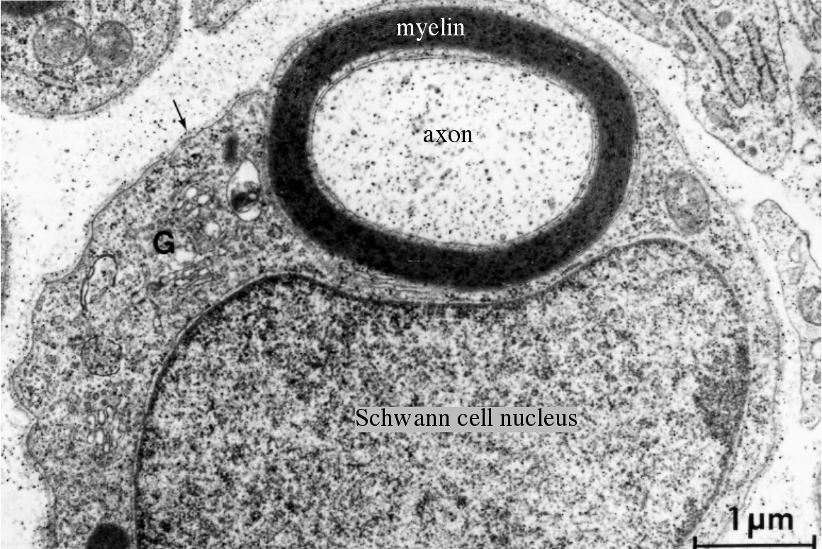
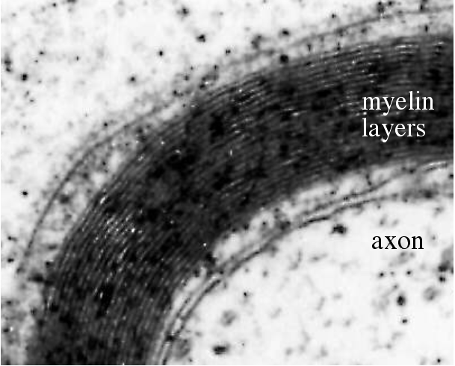
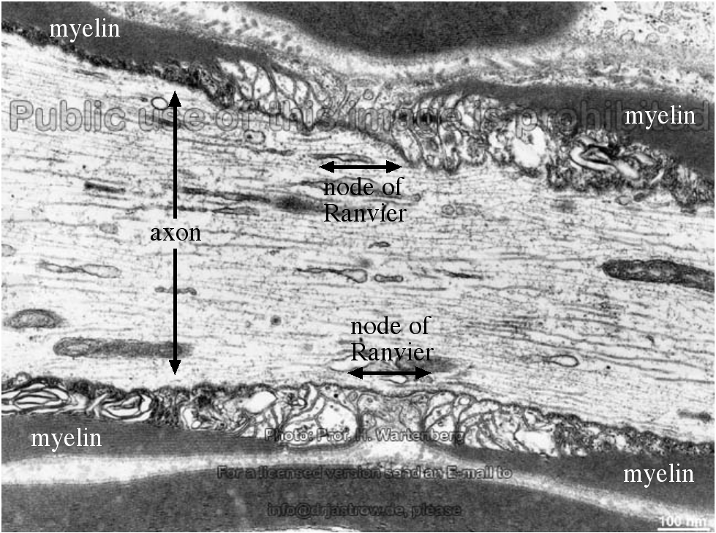
Fig. 12.12
Myelinated Axons Accelerate Signal
Notes:
Figure 12.12 Myelinated axons conduct electricity faster. (a) Electron micrograph of a Schwann cell wrapping an axon, shown in cross section. Myelin has been chemically stained black in these electron micrographs. (b) Close up of panel a. (c) Electron micrograph of a node of Ranvier shown in long section. (d) Diagram of two axons and how myelin accelerates the conductance of electricity in myelinated nerves.

Slide 16
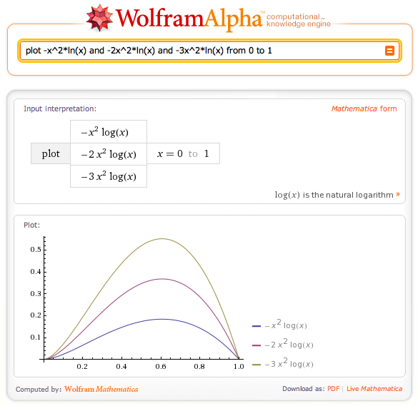
BME 12.1
BioMath Exploration
Notes:
BME 12.1 from www.wolframalpha.com

Slide 17
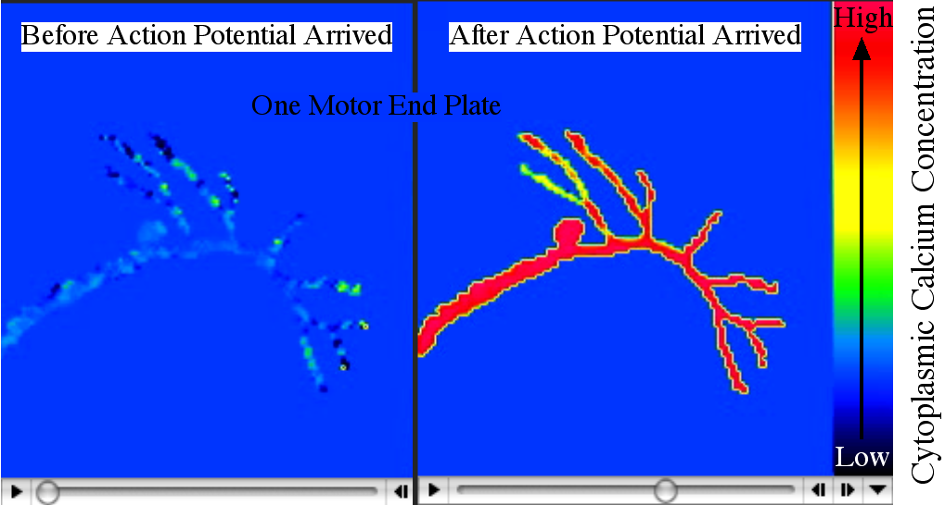
Fig. 12.13
Calcium Fluctuation in Neuron
Notes:
Figure 12.13 Action potential produces calcium influx. Screen shots from a movie showing a neuron’s terminus and the rise in cytoplasmic calcium.

Slide 18
Table 12.1
Table 12.1
Notes:
Table 12.1 Concentration of ions inside and outside animal cells.

Slide 19
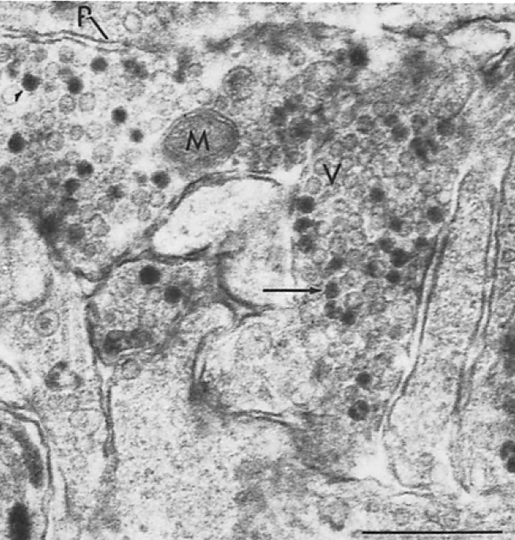
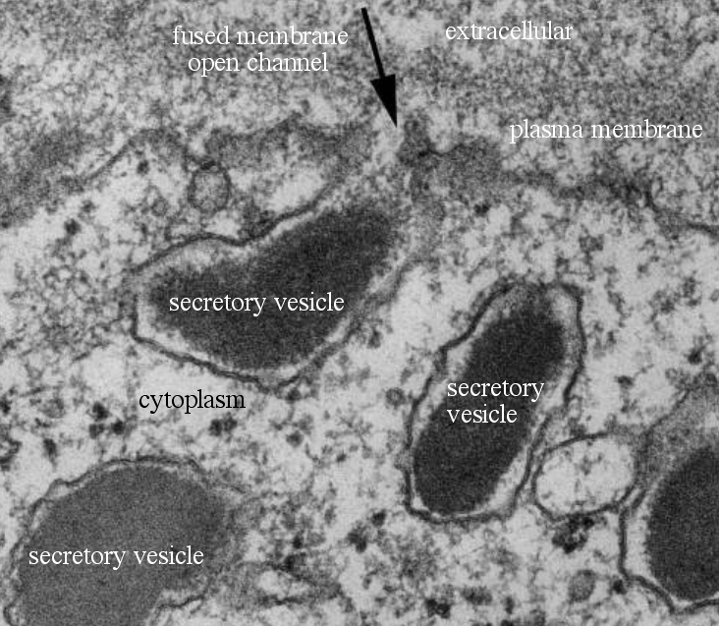
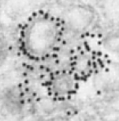
Fig. 12.14
Secretory Vesicles at Nerve Terminus
Notes:
Figure 12.14 Secretion of neurotransmitters by exocytosis. (a) Nerves accumulate secretory vesicles (V) near their plasma membranes (P) so they can quickly release their neurotransmitters; M = mitochondrion. (b) High magnification of a secretory vesicle that fused with the plasma membrane and is about to secrete the dark colored neurotransmitter. (c) Antibody labeling of a protein required for vesicle fusion with the plasma membrane.

Slide 20
Title Page
Integrated Systems Biology
PowerPoint Slides for Chapter 12:
Cells at the Cellular Level
12.2 How does all that DNA fit inside a tiny nucleus?
12.3 What is a cell?
by
A. Malcolm Campbell, Laurie J. Heyer, and Chris Paradise

Slide 21
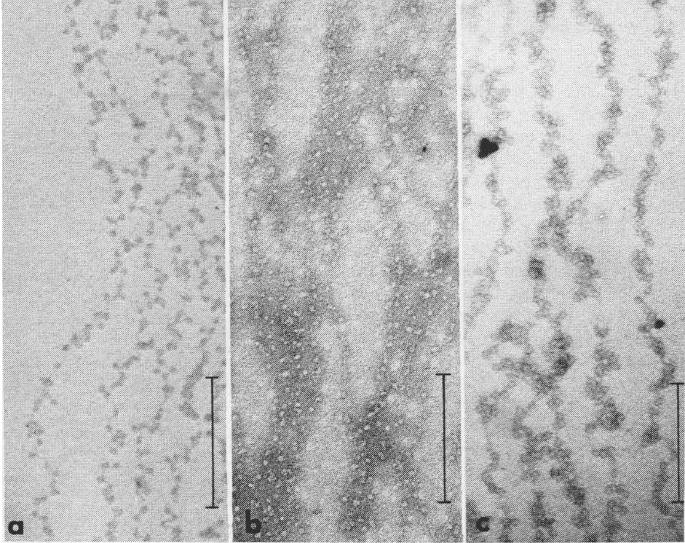
Fig. 12.15
Beads on a DNA String
Notes:
Figure 12.15 Electron micrographs of chromatin’s particles on a string. (a - b) Rat thymus prepared two different ways. (c) Chicken red blood cell chromatin. Scale bars are 2000 Å.

Slide 22
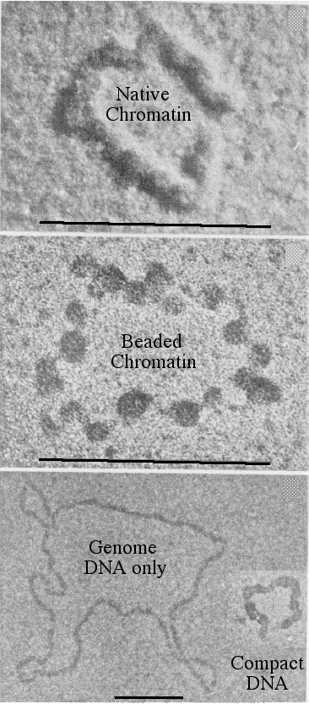
Fig. 12.16
Viral Genome Preparation
Notes:
Figure 12.16 Electron micrographs of SV40 viral DNA. (a) Viral chromatin isolated to preserve its natural state. (b) Chromatin treated to maximize beaded appearance. (c) Genome stripped of its proteins, inset shows genome condensed conformation. Bars = 1000 Å.

Slide 23
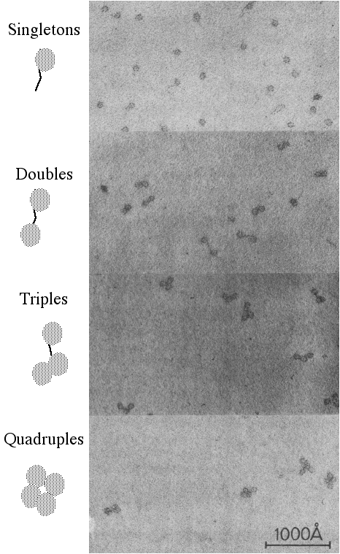
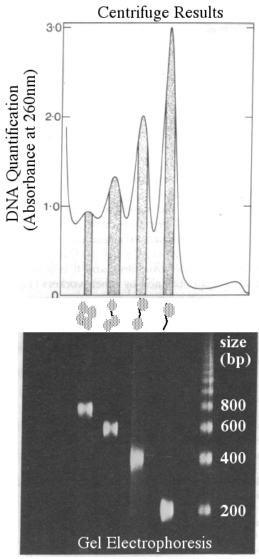
Fig. 12.17
Size of Isolated DNA “Beads”
Notes:
Figure 12.17 Separation of DNA fragments from chromatin. (a) Chromatin in units of one, two, three or four beads. (b) Chromatin centrifuged and separated by size. DNA from centrifugation sized by gel electrophoresis. DNA appears white in the gel.

Slide 24
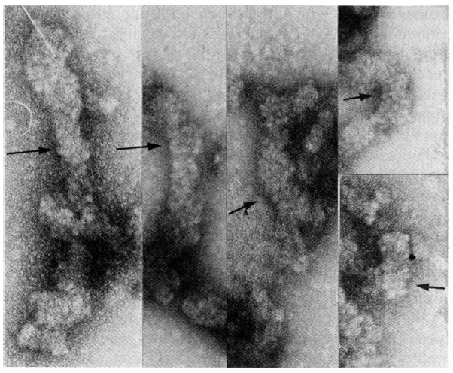
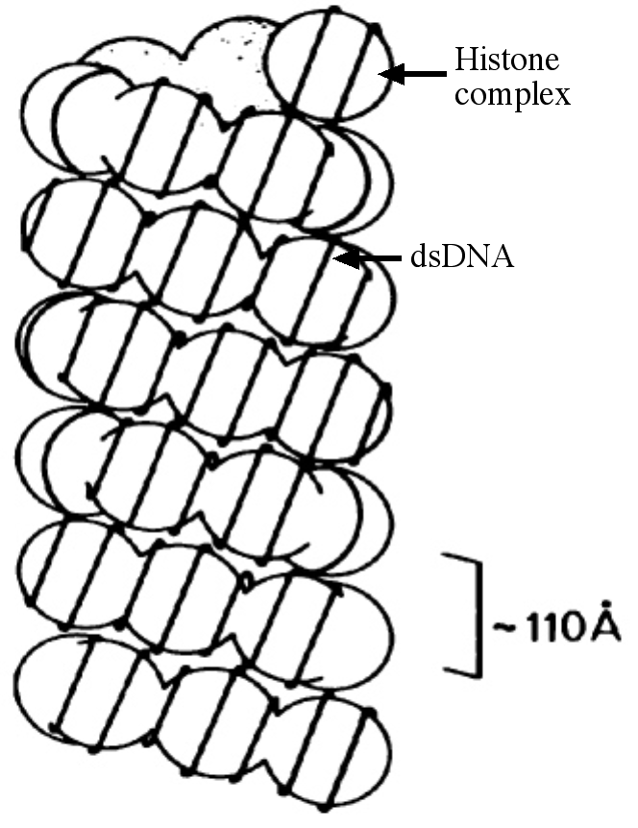
Fig. 12.18
Higher Ordered DNA Compaction
Notes:
Figure 12.18 Chromatin condenses into coils of beads. a) Electron micrograph of rat liver chromatin; arrows point to coils of beads. Magnification is 140,000 X. b) Diagram shows DNA wrapped around the white histone complexes.

Slide 25
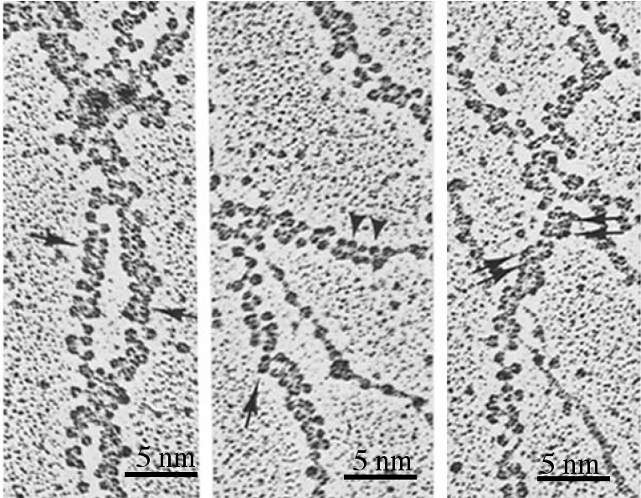
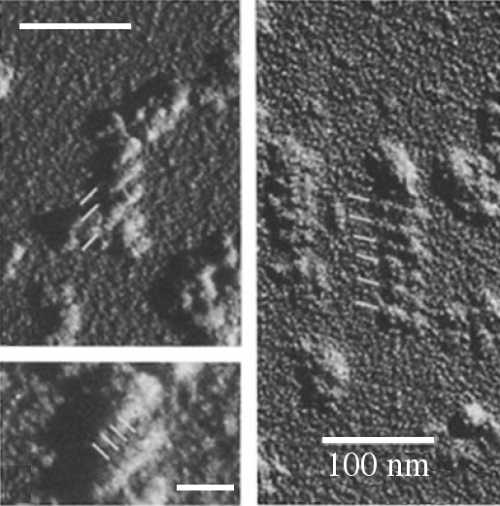
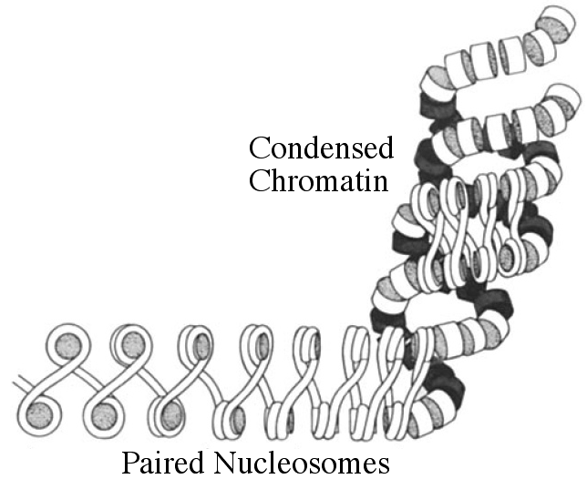
Fig. 12.19
Coils of Coiled DNA
Notes:
Figure 12.19 Higher order chromatin packing. (a) Chromatin with zig-zag nucleosome appearance; arrows indicate stacked pairs of nucleosome rows. (b) More compacted chromatin; white lines highlight the spiral coils of nucleosome ribbons. (c) Diagram of compacted chromatin. DNA is white tubes and histones are gray disks. Shading indicates 3D depth.

Slide 26
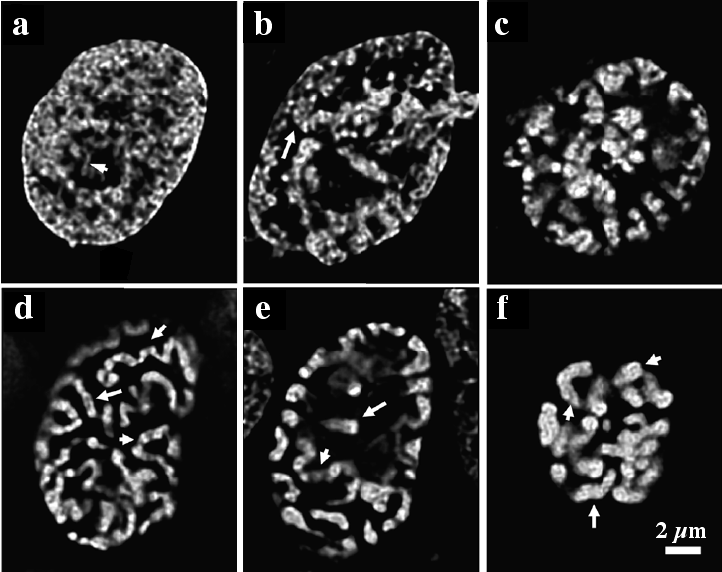
Fig. 12.20
Chromosome Prophase Condensation
Notes:
Figure 12.20 Chromosomes condensing during mitosis. (a-f) Light microscope of hamster nuclei in the earliest stages of mitosis with DNA labeled white. Arrows point to visible chromatin in a and condensed chromosomes and chromatids in (b-f).

Slide 27
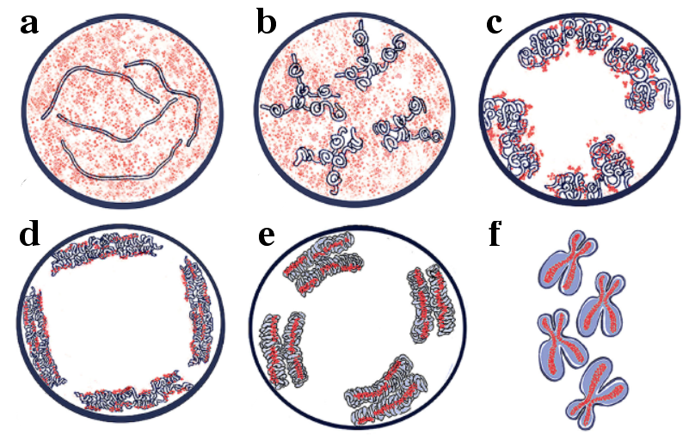
Fig. 12.21
Diagram of Prophase DNA
Notes:
Figure 12.21 Diagram of chromosomes condensing during mitosis. (a-f) Diagram shows DNA as white ribbons with the red “glue” protein inside each condensed chromatid. DNA and nucleosomes appear blue in panel (f).

Slide 28
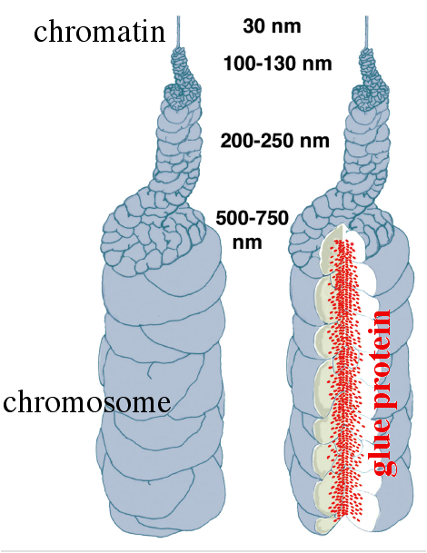
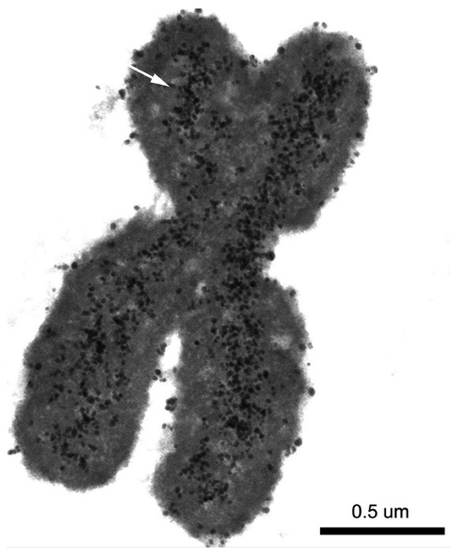
Fig. 12.22
Proposed Chromosomal Glue
Notes:
Figure 12.22 Glue protein stabilizes chromosome structure. (a) Diagram showing progressive DNA condensing (top to bottom) with glue protein in red when chromosome is cut open for viewing inside. (b) Electron micrograph of a condensed chromosome with the glue protein labeled by gold-tagged antibodies as small black dots (white arrow).

Slide 29
UN Chapter 12 figure to go with IQ #25
Histone Protein #4 Evolution
Notes:
UN Chapter 12 Figure. Alignment of 12 Histone 4 protein sequences. Colored columns highlight some conserved amino acids and dashes indicate gaps that maximize alignments.

Slide 30
12.3 What is a cell?

Slide 31
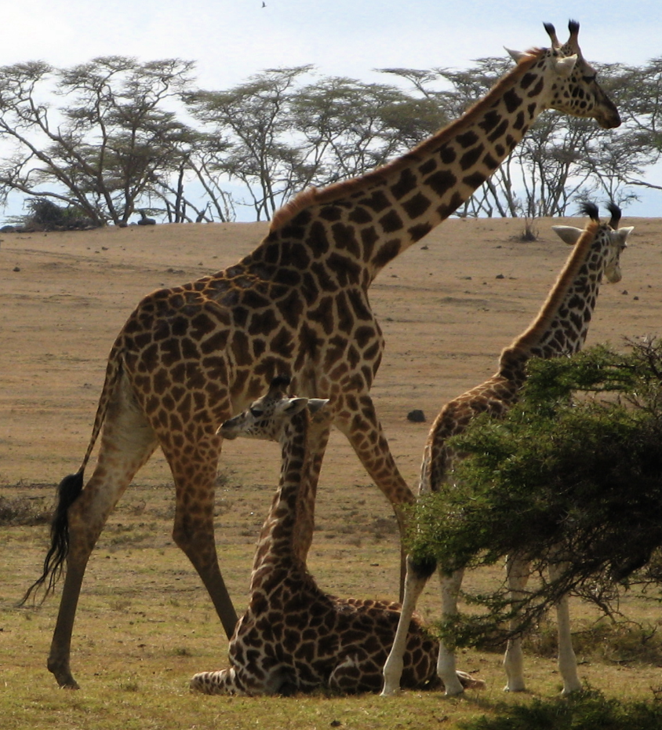
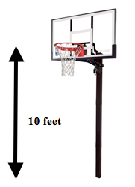
Fig. 12.23
Exceptionally Long Cells
Notes:
Figure 12.23 Giraffes have neurons with long axons. (a) Some neurons extend 10 feet, from the base of the skull to the thorax. (b) A comparable distance is a basketball goal, which is 10 feet high.

Slide 32
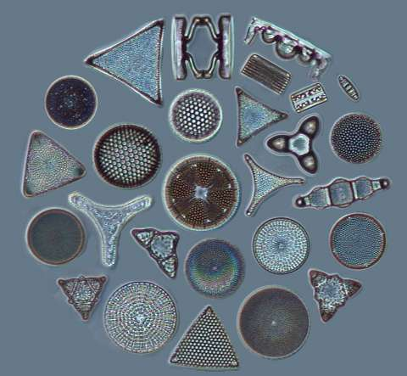
Fig. 12.24
Diatom Diversity of Shapes
Notes:
Figure 12.24 Eukaryotic diatom cells come in many shapes. Diatoms are photosynthetic plankton in the oceans and live inside silicon shells they produce. The shells come in a wide range of shapes and the cells fill their containers.

Slide 33
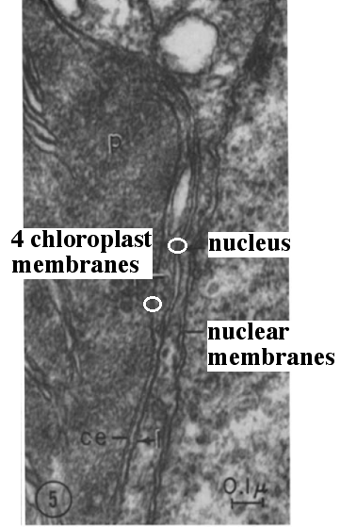
Fig. 12.25
Evolution of Diatom Cells
Notes:
Figure 12.25 Diatom evolution and membranes. (a) Diatoms are the product of one eukaryote engulfing a red alga. Diatom chloroplast is surrounded by four membranes and its genome is a blend of two different eukaryotes. (b) Electron micrograph of chloroplast (left) and nucleus (right) with two pairs of membranes circled in white.

Slide 34
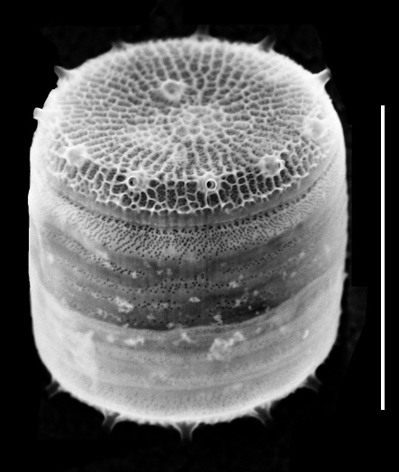
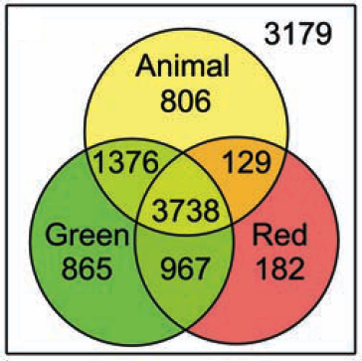
Fig. 12.26
Diatom Anatomy and Genomics
Notes:
Figure 12.26 Thalassiosira pseudonana and its genes. (a) Micrograph of the first diatom to have its genome sequenced; bar = 5 µm. (b) Numbers indicate which types of organisms share genes with diatoms.

Slide 35
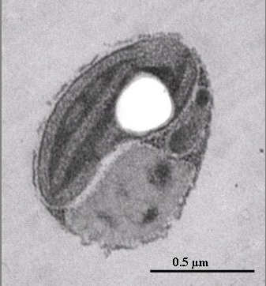
Fig. 12.27
Tiniest Eukaryote Green Alga
Notes:
Figure 12.27 Electron micrograph of the smallest eukaryote, a green alga called Ostreococcus tauri. The large white circle is a fluid-filled vacuole.

Slide 36
Table 12.2
Table 12.2
Table 12.2 Comparison of species genomic statistics. Mbp = million base pairs.
Notes:
Table 12.2 Comparison of species’ genomics statistics.

Slide 37
Fig. 12.28
Gigantic Bacterium Anatomy
Notes:
Figure 12.28 Gigantic bacterium Epulopiscium fishelsoni lives in fish intestines. (a) Light micrograph of a “binucleated” (arrows) individual prior to cell division. (b) Electron micrograph of E. fishelsoni genetic material with chromatid-like structures (arrow heads) inside the nucleus-like structure (N). Arrow points to membrane that separates DNA from cytoplasm, C. Bar in panel a = 50 µm; bar in panel b = 1 µm.

Slide 38
Fig. 12.29
E. fishelsoni Life Cycle
Notes:
Figure 12.29 E. fishelsoni life cycle and chromosomal copy number. (a) Diagram of E. fishelsoni daily life cycle with photographs of two stages. Mother cells contain two offspring cells that develop within the mother before emerging and repeating the cycle. (b) Graph depicts cell volume and the number of copies of each gene. Pink spots represent small offspring cells and blue diamonds represent larger mother cells.

Slide 39
Table 12.3
Table 12.3
Table 12.3 Gene copy number in individual E. fishelsoni cells.
Notes:
Table 12.3 Gene copy number in individual E. fishelsoni cells.

Slide 40
Fig. 12.30
Tiny Bacterium
Notes:
Figure 12.30 Minimal bacterium with length of 0.5 µm and volume of 0.01 µm³. a) The SAR11 oceanic bacterial species are the smallest group of prokaryotes. b) Pelagibacter ubique has the smallest genome of any free-living bacteria.

Slide 41
Fig. 12.31
Tiny Bacterial Genome
Notes:
Figure 12.31 The smallest genome belongs to the prokaryote Carsonella ruddii, red dot. Comparison of 385 prokaryotic genomes including 6 species of mutalistic bacterial symbionts, blue dots, 36 archaea as green dots. Yellow dots are bacteria, the smallest of which live inside other species as pathogens or outside as parasites. The photo shows light blue C. ruddii compared to the host cell nucleus.

Slide 42
Fig. 12.32
Evidence of Nanoscale Life?
Notes:
Figure 12.32 Visual evidence supporting the existence of nanobacteria. (a) Nanobacteria-like objects found on Martian meteorite called ALH84001. Arrowheads point to cell-like structures about 50 – 100 nm long. (b) Large nanobacterium appears to be dividing.

Slide 43
Fig. 12.33
Data Against Nanobacteria
Notes:
Figure 12.33 Human protein at the center of nanobacteria-like particles. (a) Investigators separated nanobacteria proteins in lane 1 or purified human protein in lane 2 (left). The proteins were visualized by anti-human protein antibodies (right). (b) Nanobacteia-like particles were labeled with gold-tagged anti-human protein antibodies and visualized by electron microscope.

Slide 44
Fig. 12.34
Color Spectrum Continuum
Notes:
Figure 12.34 The color spectrum of visible light. Can you define where green begins and ends? The color continuum is similar to the spectrum of cells.

Slide 45
ELSI Fig. 12.1
Retraction of Human Stem Cell Papers
Notes:
Figure ELSI 12.1 Reproduction of the Science retraction of two papers based on misconduct.

Slide 46
Title Page
Integrated Systems Biology
PowerPoint Slides for Chapter 12:
Cells at the Cellular Level
12.4 Are viruses alive?
by
A. Malcolm Campbell, Laurie J. Heyer, and Chris Paradise

Slide 47
Table 12.4
Table 12.4
Table 12.4 Seven types of viral genomes, examples and some details.
Notes:
Table 12.4 Seven types of viral genomes, examples and some details.

Slide 48
Fig. 12.35
HIV Reproduction
Notes:
Figure 12.35 HIV reproduces in human white blood cells. (a) HIV (red arrow) produces new virus particles when it buds out of infected human cells. Human cell forms larger bulges unrelated to the infection (green box). (b) Viral particles are surrounded by a piece of human white blood cell membrane (purple arrow) with its genome and protein wrapper inside (orange arrow). The HIV membrane contains spike proteins that facilitate infection(pink oval). (c) HIV genome map.

Slide 49
Fig. 12.36
Mimivirus Defies Virus Definition
Notes:
Figure 12.36 Mimivirus structure and evolution. (a) Mimivirus protein capsid has five-fold symmetry. (b) Viral genome exits through the five door portal. (c) Viral factory inside infected amoeba is about 5 µm in diameter; viruses in different stages of development indicated by colored arrowheads. (d) Phylogenetic tree based on seven genes; bootstrap values at branch points.

Slide 50
Fig. 12.37
Sputnik: Virus Within a Virus
Notes:
Figure 12.37 Virophage Sputnik uses the Mimivirus factory for its own reproduction. (a) Smaller Sputnik particles produced inside virus factory inside amoeba.( b) Sputnik virus particles packaged inside Mimivirus capsid.

Slide 51
Table 12.5
Table 12.5
Table 12.5 Data supporting prions contain only proteins.
Stable at 90º C for 30 minutes, which denatures many nucleic acids
Small size, about 50,000 Daltons which is the size of a typical protein
Resistant to RNase and DNase
Resistant to UV light, which damages nucleic acids
Resistant to chemical modifications that inactivate nucleic acids
Notes:
Table 12.5 Data supporting prions contain only proteins.

